Slide 1

Cifar10 Image Classification
Pavan Sai Prasanth Sabnaveesu
sabnaveesuprasanth@gmail.com
(+91) 7730081608

Slide 2
Agenda
01
Introduction
02
Execution Procedure
03
Model without augmentation
04
Model with augmentation
05
Conclusion
06
Futuristic

Slide 3
Introduction
This is a state-of-art Dense Net code of cifar10 data set
It is classification problem statement of different categories like animal, bird, automotive

Slide 4
Execution Procedure
Step 1
Step 3
Loaded cifar10 data
Used data Augmentation techniques like Rotate, horizontal flip, width shift range, height shift range
Step 2
Step 4
Converted all pixels into matrix and followed by categorical form
Input layer, hidden layer and finally output layer is kept unchanged as per given architecture

Slide 5
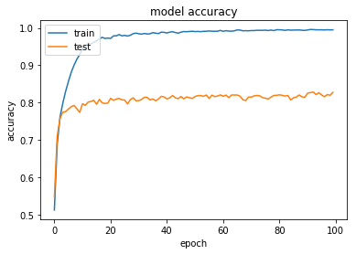
Model Without Augmentation
Model accuracy using Augmentation technique is 81.2%
Train:
Test loss: 0.16 Train accuracy: 98.4
Test:
Test loss: 0 Test accuracy: 81.12

Slide 6
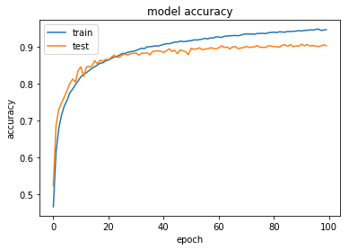
Model using Augmentation
Model accuracy using Augmentation technique is 81%
Train:
Test loss: 0.16 Train accuracy: 98.4
Test:
Test loss: 0 Test accuracy: 94.5

Slide 7
Challenges Faced
To try multiple implementations using various techniques and performing analysis was rough, each technique is consuming a lot of time
As a result, model fitting kernel was interrupted quite a few times

Slide 8
Thank You

